Slide 1
Databook: Data Analysis
An Bouckaert Maarten Durieu
Sam Pauwels Artur Tyvaert
Group 1

Slide 2
Outline
Products
Customers and their behaviour
Employees and their behaviour
Location and route analysis
Notes:
General intro and everyone introduces

Slide 3

Products

Slide 4
"What is our core business?"
Revenue | Description | Family
€ 89 147.80 | 2.5L Vanille | Scoop Ice
€ 82 935 | Cornets d’Amour | Hand Ice
€ 39 619.10 | Assortiment XXL | Assortments
€ 36 932.50 | Maxi Vanille/24 | Hand Ice
€ 29 971.50 | Big Chocolate/20 | Hand Ice
€ 29 516.50 | Cornets d’Amour Vanille/16 | Hand Ice
€ 27 579.60 | 1 L Vanille | Scoop Ice
€ 27 230.10 | 5 L Vanille | Scoop Ice
€ 26 584.30 | Dessert Dame Blanche/14 | Cups
€ 23 768.80 | Vanille 2.5 L +0.5L gratis | Scoop Ice

Slide 5
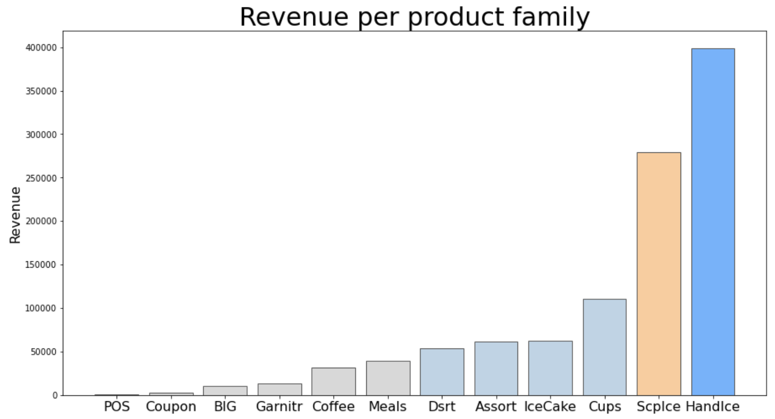

Slide 6
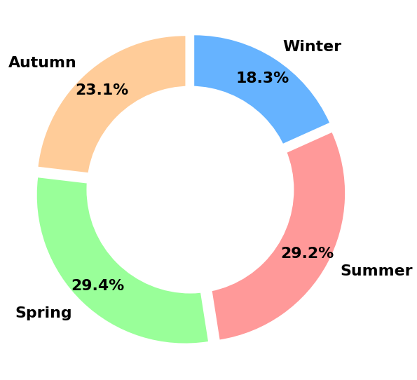
Seasonality of sales

Slide 7
Product recommendations
Basic guidelines for the employees
Hand Ice
Same product family
Product catalogue
Customer based product recommendations
Based on sales history
Based on similar customers

Slide 8
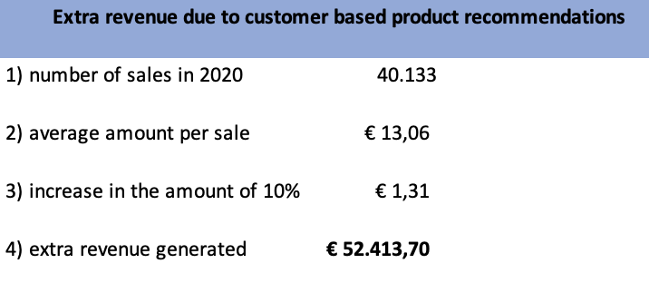
The effect of product recommendations
Extra revenue due to
customer based product recommendations
1) Number of sales in 2020
€ 40 13300
2) Average amount per sale
€ 13,06300
3) Increased amount of 10%
€ 1,3100000
4) Extra revenue generated
+ € 52 413,70

Slide 9
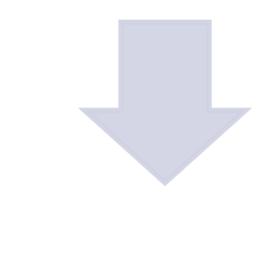
Summary
Hand and Scoop Ice = most Revenue
Everybody loves Vanille!
Sell Products based on customer recommendation
Higher temperatures = higher Sales

Slide 10

Customers

Slide 11
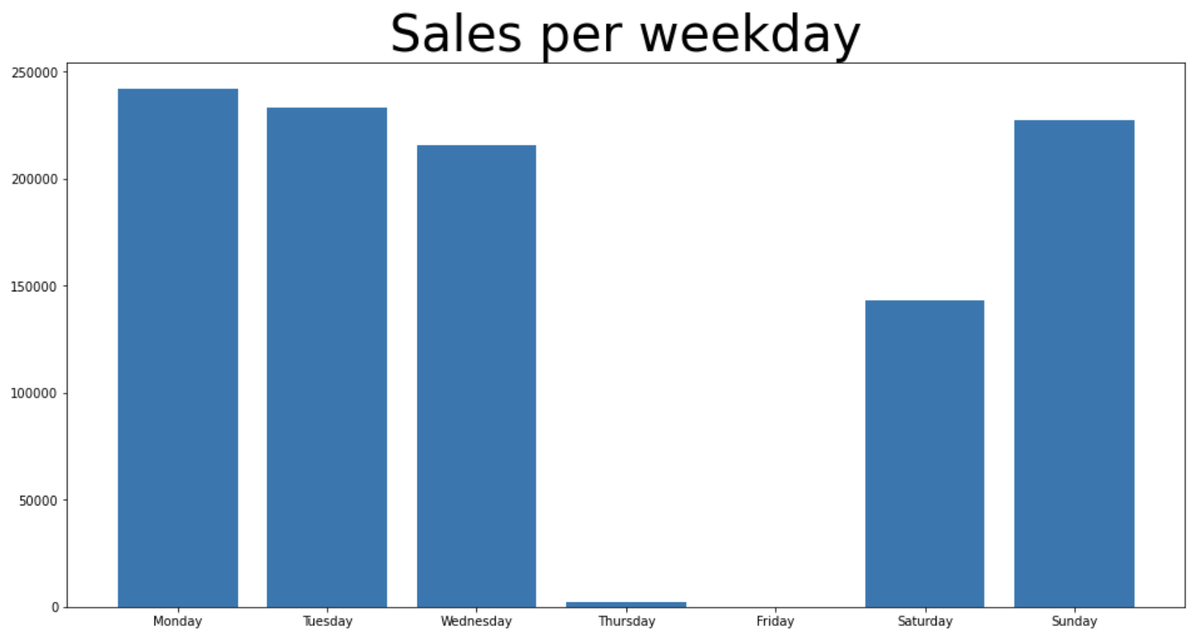
Buying patterns per weekday
Revenue

Slide 12
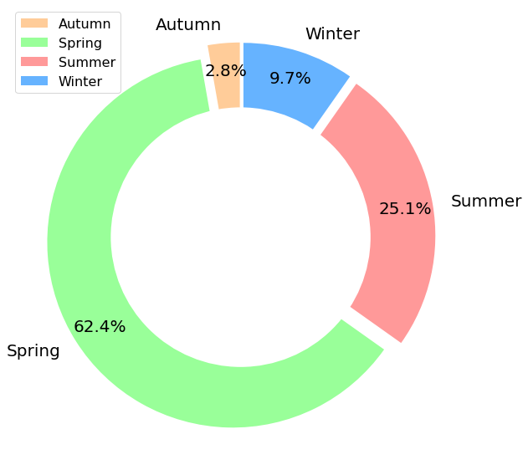
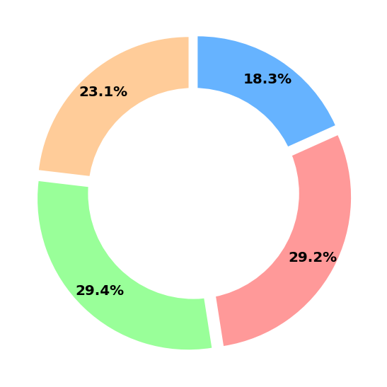
Churners
Normal
Churner
"Customers who have not bought
a product for alteast one year"

Slide 13
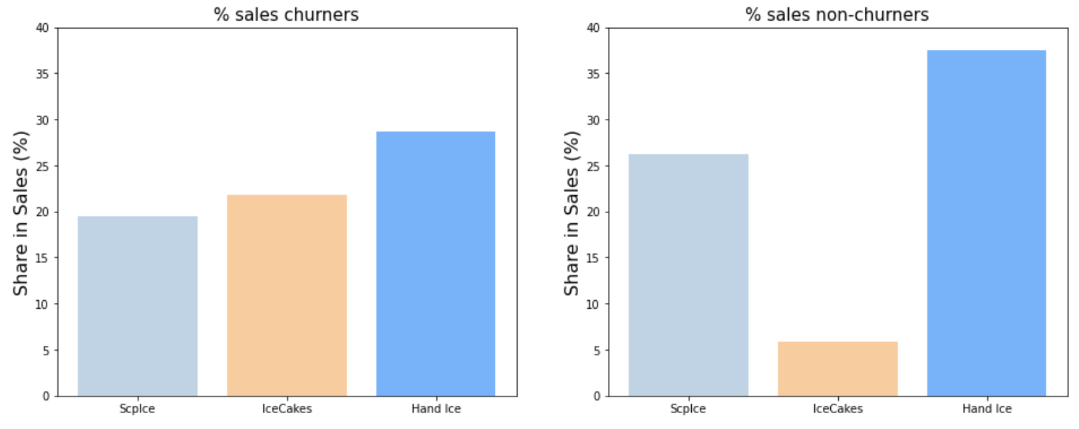
Churners buy more Ice Cakes!

Slide 14
 | No Churn | Churn | No Churn | Churn
Excellent service, very satisfied | 474 | 0 | 100% | 0%
Good service, satisfied | 2169 | 8 | 99.63% | 0.37%
No opinion | 1915 | 64 | 96.62% | 3.38%
Not completely satisfied | 367 | 62 | 85.55% | 14.45%
Very bad service, very unsatisfied | 48 | 2 | 96% | 4%
Our company scores 6.27/10

Slide 15


“Only just 1 percent of our best customers
Already counts for 19% of our total CLV”

Slide 16
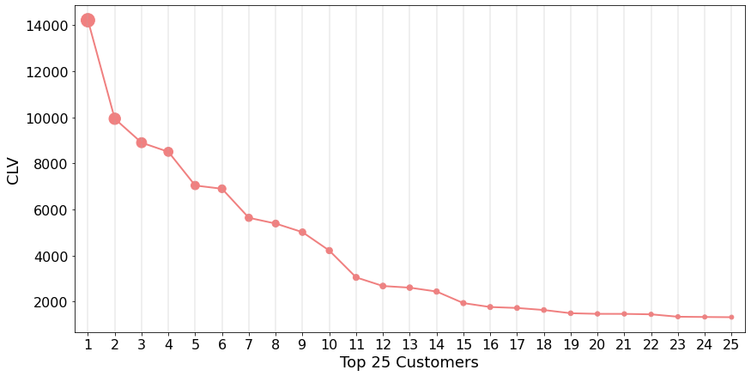
Then Who should be rewarded?

Slide 17
Let’s make a sum:
Top 10 Catering/Horeca 7.12%
+
Top 50 Private Customers 11.58%
=
19 % total CLV by only 60 of our 5703 total customers

Slide 18
What do we recommend?
Reward your best CLV customers
Increase customer relationships -> Discounts, loyalty program, samples etc
Work on promos for Spring and Ice Cakes (Churners)
Opinions matter: look at reviews they show churners!

Slide 19

Employees

Slide 20
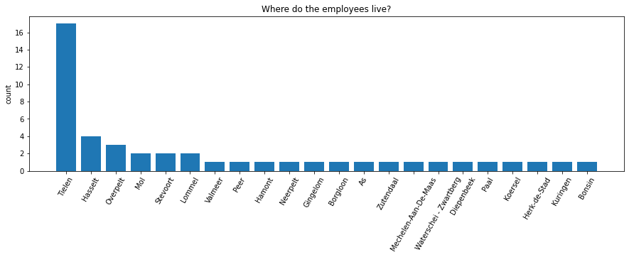
Where do our 35464employees live?

Slide 21
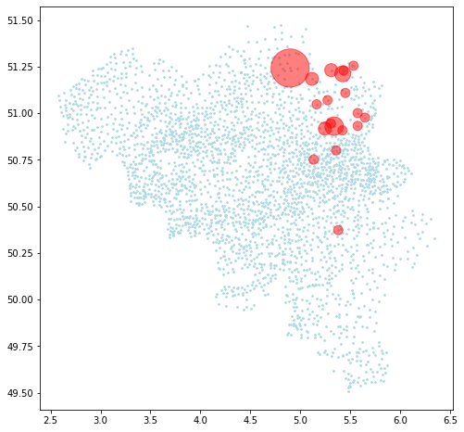

Slide 22
Only 1 of the 46 employees speaks French
Only 6 of the 5703 customers speaks French
But they are not connected…

Slide 23
Sales rate
Name | Number of success visits | Sales Rate
VAN HECKE jan | 21188 | 38.954258
PEETERS michel | 18547 | 34.882453
BUFFEL Sandy | 15003 | 34.097727
VERRESEN Dirk | 7064 | 31.076503
VERSTRAETE Erik | 4227 | 22.286076
MATTIJS stijn | 3535 | 39.225477
DE PAUW Kim | 3503 | 21.385836
KERCKAERT Pieter | 1665 | 26.610197
CLAUS David | 1188 | 26.358997
BALLINGS Hendrik | 630 | 40.050858
TACK Hann | 438 | 26.040428
DE SMET Stijn | 395 | 23.140012
VAN HUFFEL Jan | 351 | 36.222910
PAUWELS Jeffrey | 271 | 22.527016
STEEMAN Evy | 266 | 26.626627
DE CONINCK Marnik | 247 | 28.888889
JANNSENS Eddy | 178 | 22.139303
DE BRUYNE Charlotte | 103 | 18.625678
DE BRUYNE Chris | 43 | 19.111111
CLAEYS Liebeth | 37 | 16.157205
QUINTEN Patrick | 16 | 76.190476
DE MILT Tomas | 12 | 12.244898
DE BAERE Sonja | 7 | 46.666667
DESTORME Frederik | 6 | 50.000000
JACOBS Michel | 3 | 14.285714
DE TREMERIE Dimitri | 2 | 40.000000
VERLINDEN Elke | 2 | 100.000000
MORTIER Magda | 1 | 50.000000
CABOOTER Dries | 1 | 100.000000
VAN AALST Sofie | 1 | 12.500000

Slide 24
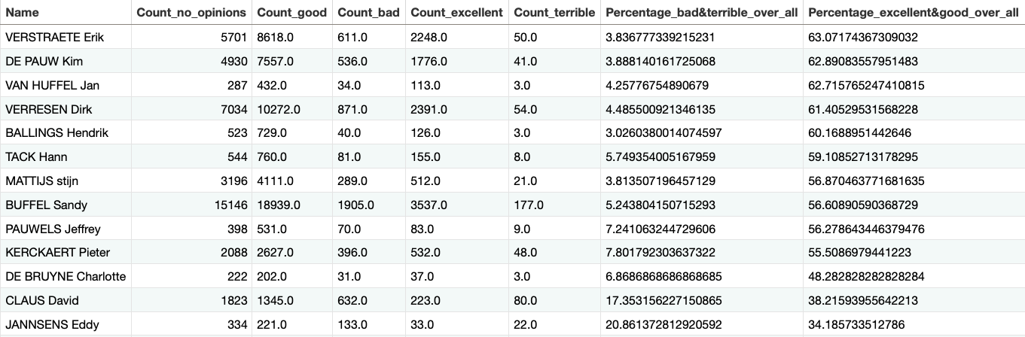
Who should be rewarded or trained

Slide 25
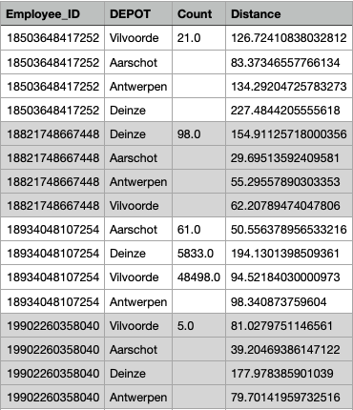
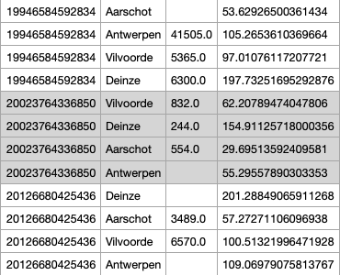
Which employees should be assigned to different routes?
…

Slide 26
Location and route analysis
General location of our customers
Current routes
Potential changes: routes
Potential changes:depots

Slide 27
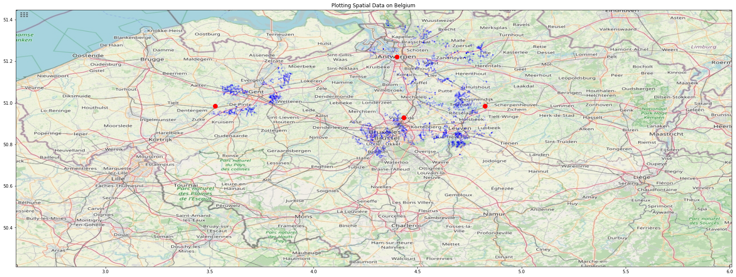
Customers are positioned in large clusters
 | Depot
 | Customer

Slide 28
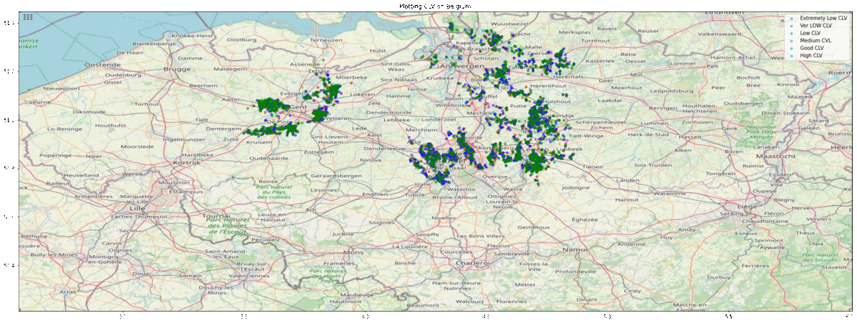
Plotting the CLV of the customers
 | CLV < 100
 | 100 < CLV < 200
 | 200 < CLV < 300
 | 300 < CLV < 400
 | 400 < CLV < 500
 | 500 < CLV

Slide 29
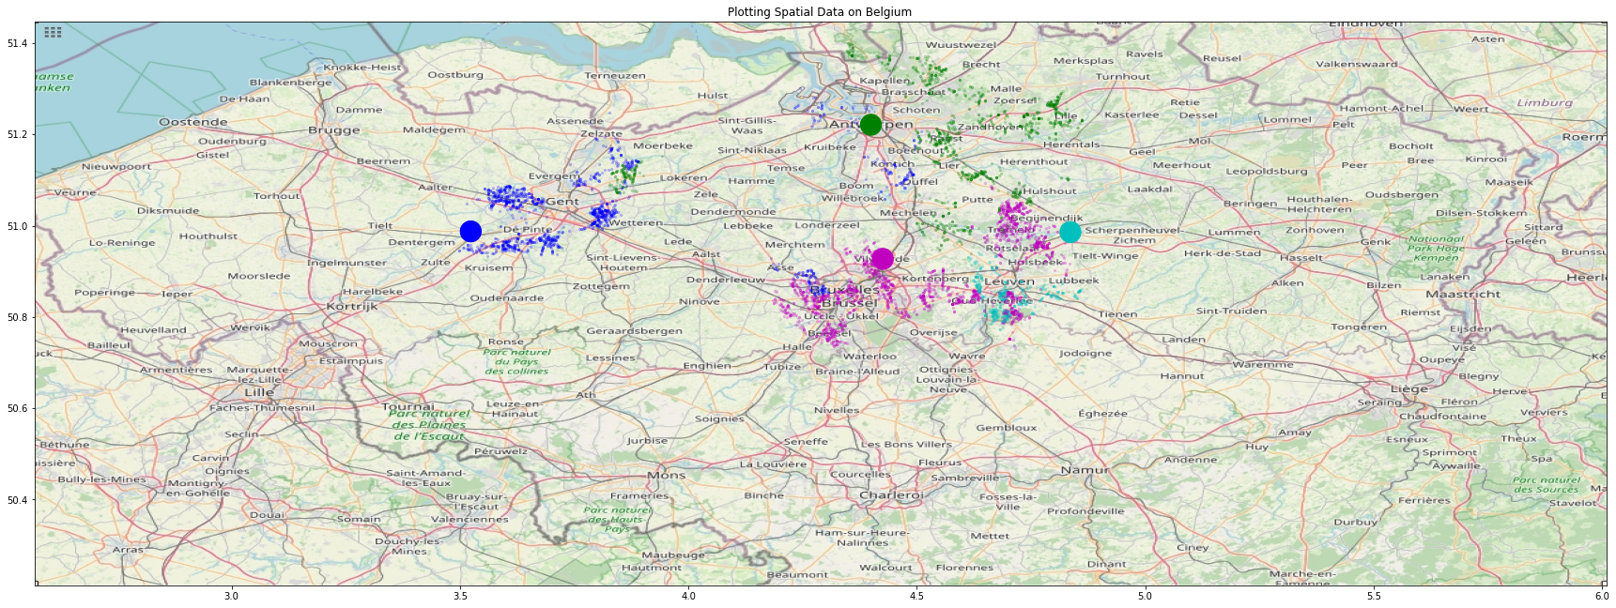
The current route assignment per depot
 | Antwerp
 | Deinze
 | Vilvoorde
 | Aarschot

Slide 30
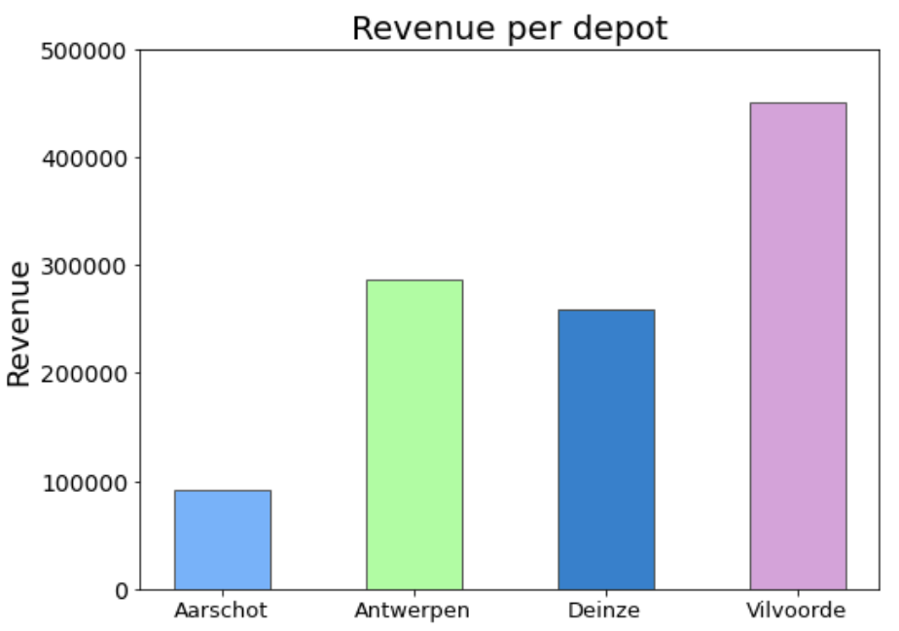
Current revenue per depot
Large difference in revenue sdover all depots

Slide 31
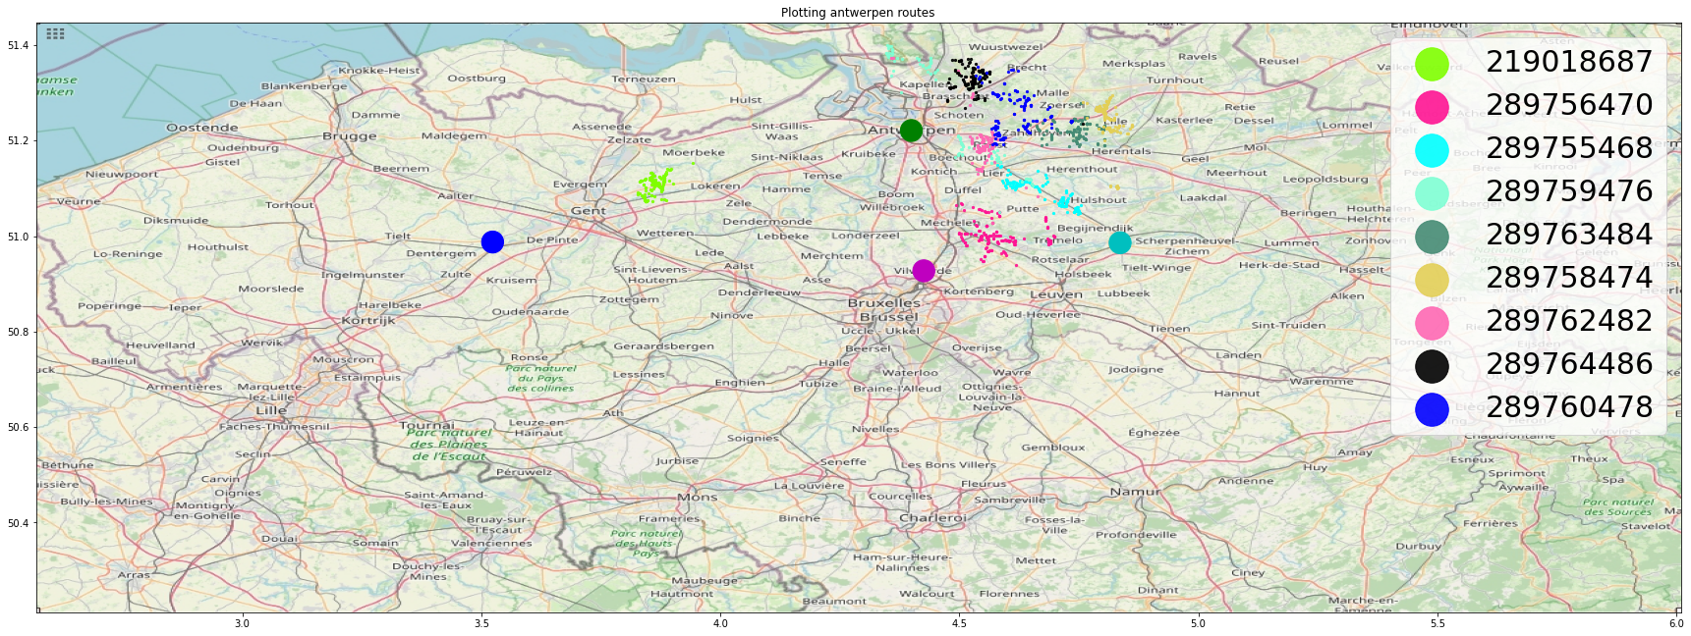
Potential improvements in the current routes

Slide 32
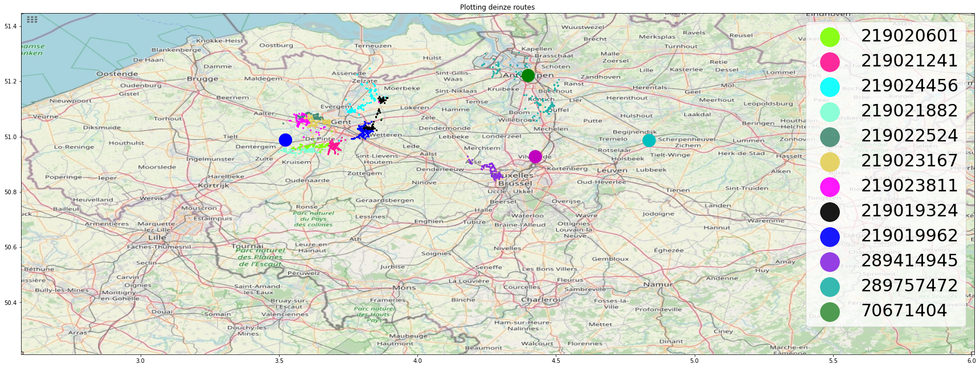
Potential improvements in the current routes

Slide 33
Potential improvements in the current routes

Slide 34
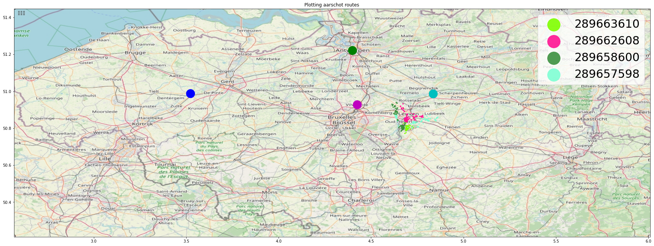
Potential improvements in the current routes

Slide 35
Potential improvements in the depots
 | depot
 | customer

Slide 36
Route conclusion
Invest in new (and current) relationships with customers located closer to major city centers (such as Brussels, higher mean income).
Re-assign the routes to depots that are closer. (appx 4.1a & 4.1b)
Increase in fuel efficiency, savings of at least 2000+ euros per year
Reduce potential overpay of at least several thousand
Better time management for employees leads to happier employees and better reviews
Re-assign customer outliers to routes that are closer
Better time management for employees leads to happier employees and better reviews
Less fuel cost
Open potential depots:
To aim for expansion towards the south of Belgium -> Waver for example
To reduce pressure on depots such as Vilvoorde (12 routes) and Aarschot (9 routes)

Slide 37

Thank you for your attention
Are there any question?

Slide 38
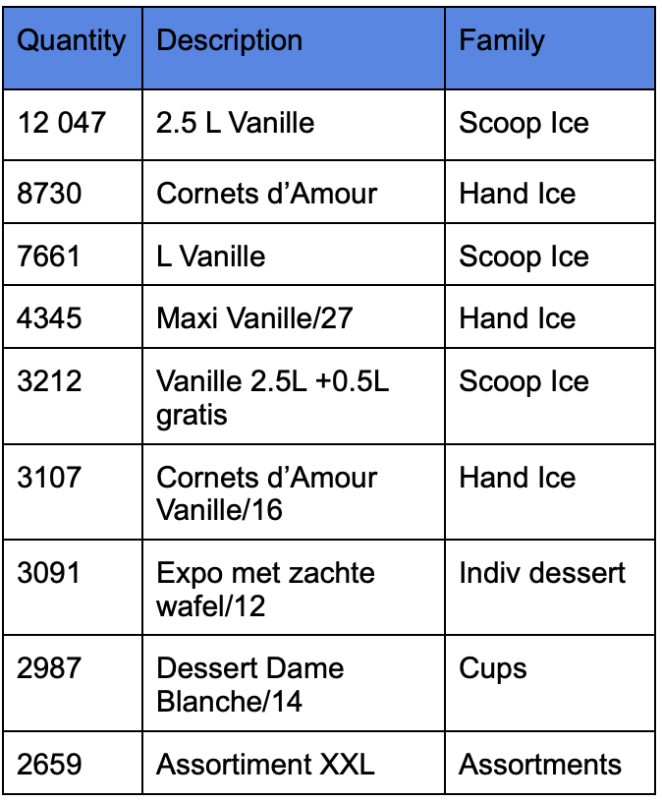
App 1.1
- Top 10 products per quantity sold

Slide 39
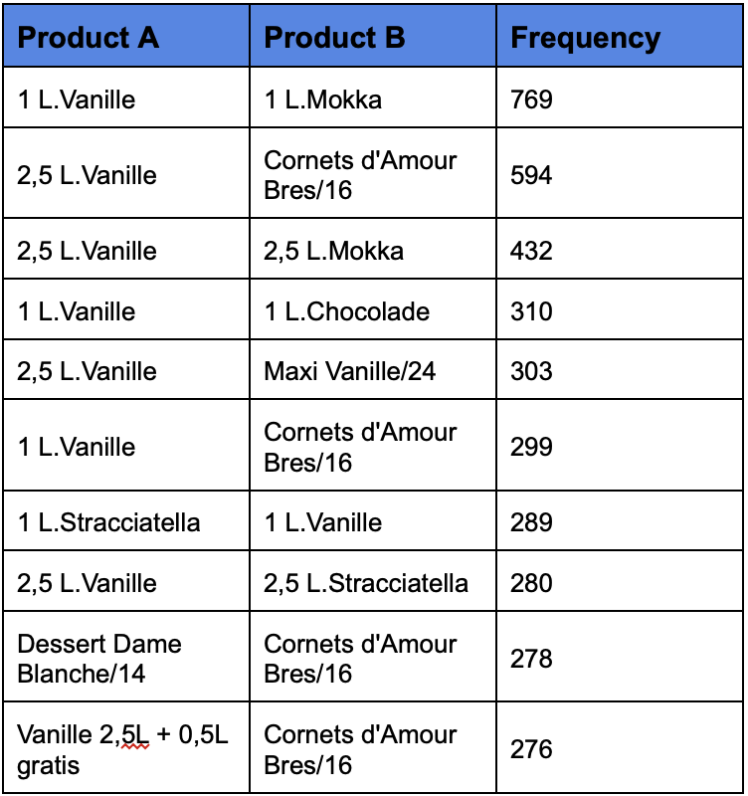
App 1.2
The product catalogue

Slide 40
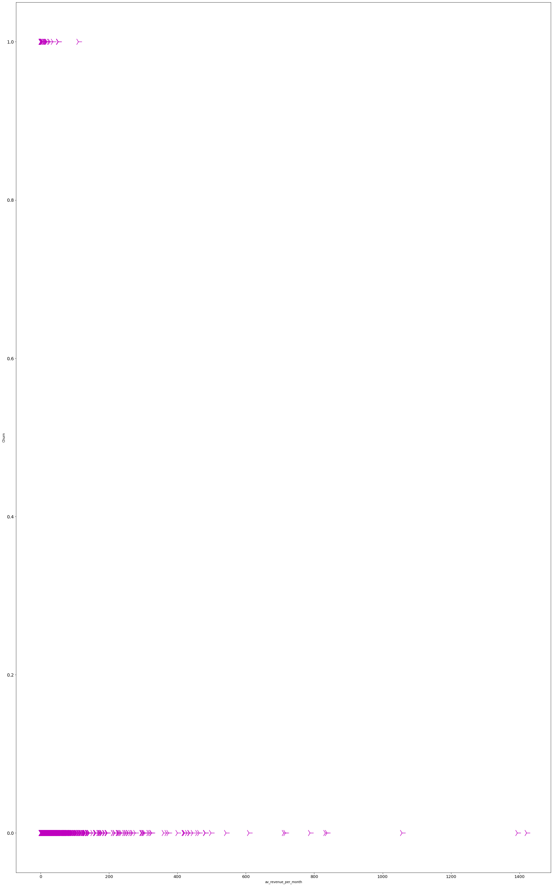
App 2.1 average revenue per month

Slide 41
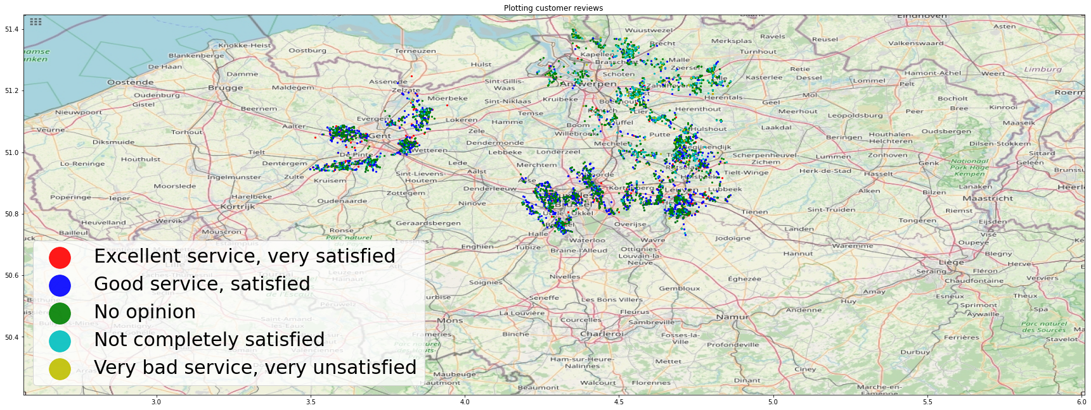
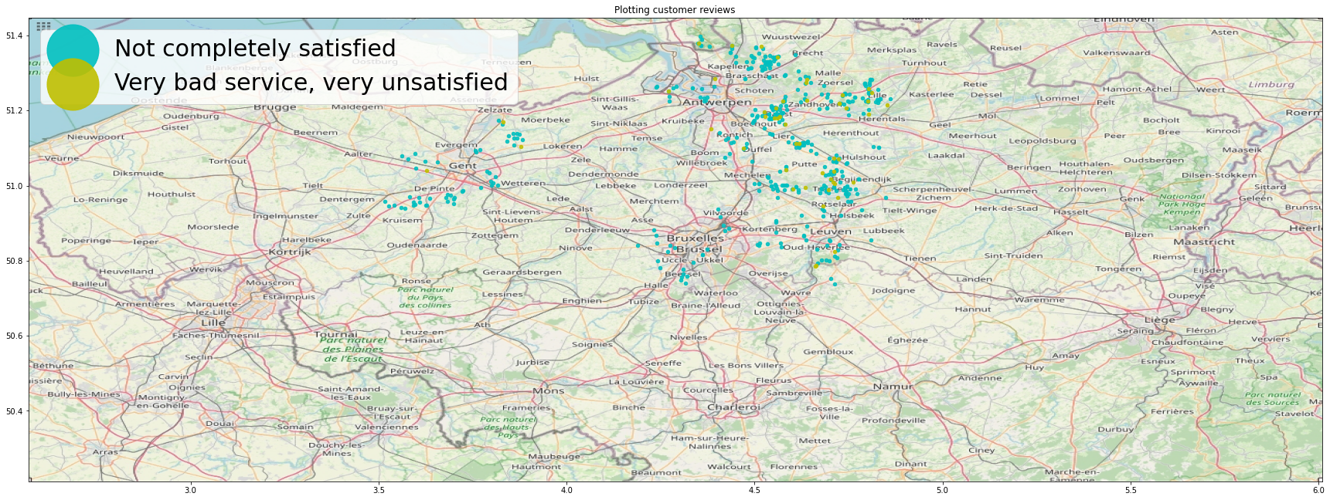
App 2.2 Reviews on location

Slide 42
Appx 4.1a
Deinze
219018687
219020601
219021241
219024456
219021882
219022524
219023167
219023811
219029324
219029962
70671404
Antwerpen
289757472
289759476
289763484
289758474
289762482
289764486
289760478
Vilvoorde
289414945
289756470
289416949
289419955
289417951
289418953
289411939
289412941
289413943
289655594
289660604
289664612
Aarschot
289755468
289761480
289661606
289659602
289656596
289663610
289662608
289658600
289657598
Deinze
289757472
289414945
Antwerp
219018687
289756470
289755468
Vilvoorde
289656596
289659602
289761480
289661606
Aarschot
Left: route transition to new depot. Right: overview of the new list of routes per depot. Blue cells are new routes for that depot.

Slide 43
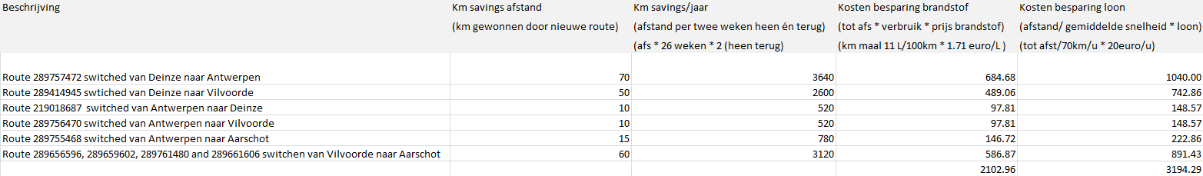
App 4.1b

